Slide 1
Intro To AI
Sheet 2
Abdulrahman ElMadkhoum

Slide 2
Q.1) Describe the following terms
a. State Space Graph: A directed graph (V, E) where the set of vertices V represents all valid configurations (states) of a problem, and the directed edges E correspond to valid operators/actions that transition the system from one state to another.
b. Exhaustive Search: An unguided, brute-force search strategy (such as Breadth-First Search or Depth-First Search) that systematically evaluates every single node in a state space until a solution is found or the entire space has been traversed.
c. Heuristics: Problem-specific criteria or rules-of-thumb that estimate the remaining cost from a given state to a goal node. They are used to guide a search algorithm down paths that are more likely to lead to an optimal solution quickly.
d. Path: An ordered sequence of states (s₀ , s₁ , s₂ , ….., s_{n}) such that for each i, there exists a legal operator that transitions the system from state s_{i} to s_{i+1}.
e. Rooted Graph: A graph structure that designates a specific, prominent node s₀ as the starting node (root), from which all other reachable states in the state space graph are evaluated.
f. Tree: A specialized type of connected graph containing no cycles, meaning there is exactly one unique path between any two vertices in the structure.

Slide 3
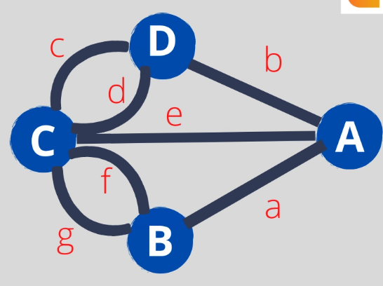
Question 2: Describe using drawing the Königsberg problem "Euler Tour."
The ancient town of Königsberg was divided into four land masses by the river Pregel. Seven bridges connected these land masses. The people of Königsberg created a game to find a path that would allow them to walk all over the town crossing the seven bridges exactly once. This problem came to be known as the Seven Bridges of Königsberg.
The people of Königsberg liked to walk around the city. They created a game among themselves- Find a path that would allow them to cover all four regions using the seven bridges but - each bridge should be crossed exactly once.

Slide 4
Question 3: Determine whether goal-driven or data-driven search would be preferable for solving each of the following problems.
Justify your answer.
3.a. You have met a person who claims to be your distant cousin, with a common ancestor named John Doe. You would like to verify her claim.
Preference: Goal-Driven Search (Backward Chaining).
Justification: You start with a specific target hypothesis: "John Doe is our common ancestor." You can track the family lineage backward from both you and your cousin to see if they meet at John Doe, narrowing the search space compared to tracking every descendant from a broad set of family data.

Slide 5
Question 3: Determine whether goal-driven or data-driven search would be preferable for solving each of the following problems.
Justify your answer.
3.b. Another person claims to be your distant cousin. He doesn't know the common ancestor's name but knows that it was no more than eight generations back. You would like to either find this ancestor or determine that she didn't exist.
Preference: Data-Driven Search (Forward Chaining).
Justification: Because the target ancestor's name is completely unknown, you cannot search backward from a specific goal. Instead, you must start with the known data points (you and the cousin) and step forward generation-by-generation through the family trees to find a match.

Slide 6
Question 3: Determine whether goal-driven or data-driven search would be preferable for solving each of the following problems.
Justify your answer.
3.c. A theorem prover for plane geometry.
Preference: Goal-Driven Search (Backward Chaining).
Justification: Geometry proofs usually give you a specific statement to prove (the goal). Searching backward from that target statement to find the required axioms or lemmas helps keep the search focused, avoiding the massive number of irrelevant statements generated when mixing random geometric axioms forward.

Slide 7
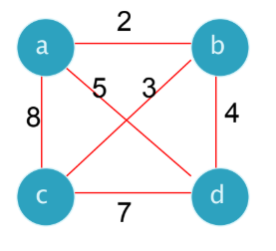
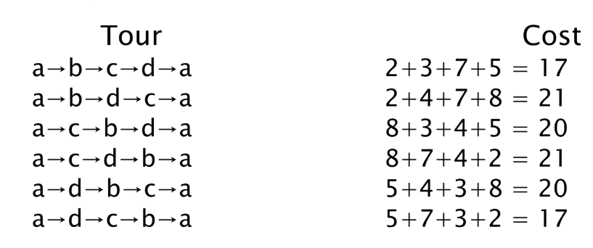
4.a. Discuss briefly the techniques used to reduce the search complexity when solving the Traveling Salesman Problem.
Given n cities with known distances between each pair, find the shortest tour that passes through all the cities exactly once before returning to the starting city

Slide 8
4.a. Discuss briefly the techniques used to reduce the search complexity when solving the Traveling Salesman Problem.
To control the O(n!) exponential growth of a brute-force TSP search space, we use the following techniques:
Heuristics: Using greedy approaches like the Nearest Neighbor heuristic or Minimum Spanning Tree (MST) approximations to estimate the remaining travel distance.
Branch and Bound: Branching out alternative paths while tracking the best complete tour found so far. If a partial path's cost exceeds this threshold, that entire branch is pruned.
Dynamic Programming: Using the Held-Karp algorithm to reduce complexity to O(n² * 2^{n}) by saving and reusing solutions to overlapping sub-problems.

Slide 9

4.b. The following is a problem which can be solved using state-space search techniques:
The Cannibals and Missionaries problem:
The following is a problem which can be solved using state-space search techniques: The Cannibals and Missionaries problem: "Three cannibals and three missionaries come to a crocodile infested river. There is a boat on their side that can be used by either one or two persons. If cannibals outnumber the missionaries at any time, the cannibals eat the missionaries. How can they use the boat to cross the river so that all missionaries survive?" Formalize the problem in terms of state-space search.

Slide 10
4.b. The following is a problem which can be solved using state-space search techniques:
The Cannibals and Missionaries problem:
4.b.1 Suggest a suitable representation for the problem state.
We represent the state as a tuple: (M, C, B), where:
M: Number of Missionaries on the Left (Initial) Bank→ {0, 1, 2, 3}
C: Number of Cannibals on the Left (Initial) Bank → {0, 1, 2, 3}.
B: Position of the boat →1 (Left Bank), 0 (Right Bank).
The quantities on the Right Bank are implicitly calculated as (3 - M) and (3 - C).

Slide 11
4.b. The following is a problem which can be solved using state-space search techniques:
The Cannibals and Missionaries problem:
4.b.2 State what the initial and final states are in this representation.
Initial State (s₀): (3, 3, 1) — All people and the boat are on the Left Bank.
Final State (s_{g}): (0, 0, 0) — All people and the boat are on the Right Bank.

Slide 12
4.b. The following is a problem which can be solved using state-space search techniques:
The Cannibals and Missionaries problem:
4.b.3 State the available operators/rules for getting from one state to the next, giving any conditions on when they may be applied.
Let an operator be represented as Move (m, c), where m is the number of missionaries and c is the number of cannibals boarding the boat (1 <= m+c <= 2).
Valid Boat Configurations: Move(1,0), Move(2,0), Move(0,1), Move(0,2), Move(1,1).
State Updates:
If B=1 (moving Left → Right): M_{new} = M - m, C_{new} = C - c, B_{new} = 0.
If B=0 (moving Right → Left): M_{new} = M + m, C_{new} = C + c, B_{new} = 1.
Safety Constraints (Must hold true for all states):
Boundary Bounds: 0 <= M_{new}<= 3 and 0 <= C_{new}<=3.
Left Bank Safety: If M_{new} > 0, then M_{new} >= C_{new}
Right Bank Safety: If (3 - M_{new}) > 0, then (3 - M_{new}) >= (3 - C_{new}).

Slide 13
4.b. The following is a problem which can be solved using state-space search techniques:
The Cannibals and Missionaries problem:
Move(1,0), Move(2,0), Move(0,1), Move(0,2), Move(1,1).
4.b.4 Draw the first two levels of the directed state-space graph for the given problem.
[3,3,1]
Move(0,2)
Move(0,1)
Move(1,1)
[3,2,0]
[2,2,0]
[3,1,0]
Move(0,1)
Move(1,1)
Move(0,2)
Move(0,1)
Move(1,0)
[3,3,1]
[3,3,1]
[3,2,1]
[3,3,1]
[3,2,1]
(intial state)
(intial state)
(intial state)

Slide 14
4.c. Briefly discuss the advantages and disadvantages of depth and breadth first search. What sort of problem is each appropriate for?
Algorithm | Advantages | Disadvantages | Best Suited For
BFS | • Guarantees finding the shallowest, most optimal solution path. • Avoids getting stuck in infinite loops. | • High memory footprint O(b^{d}) because it holds all open frontier nodes in memory. | Problems where the solution is close to the root, or path optimality is critical.
 | • Low memory requirement O(b * d). • Can quickly find deep solutions if well-guided. | • Not guaranteed to find the shortest path. • Risks getting trapped down infinite branches. | Graph problems with many alternative solutions, deep target nodes, or severe memory limits.

Slide 15
4.d. How does the use of a closed node list reduce the amount of search required in graph search?
A closed node list tracks all states that have already been expanded. Before expanding a new state, the algorithm checks the closed list. If the state is found, it is discarded. This prevents the algorithm from falling into infinite loops caused by cycles, and avoids wasting time re-evaluating duplicate states over and over again.

Slide 16
4.e. "A farmer with his dog, rabbit and lettuce come to the east side of a river they wish to cross. There is a boat at the river’s edge, but of course only the farmer can row. The boat can only hold two things (including the rower) at any one time. If the dog is ever left alone with the rabbit, the dog will eat it. Similarly, if the rabbit is ever left alone with the lettuce, the rabbit will eat it. How can the farmer get across the river so that all four characters arrive safely on the other side?"

Slide 17
Initial State: (E, E, E, E) — Everyone is on the East Bank.
Target State: (W, W, W, W) — Everyone has crossed to the West Bank.
Initial State: [F: E, , D: E, , R: E, , L: E]
Action: Farmer takes the Rabbit to the West Bank.
(The Dog and Lettuce are left on the East bank, which is safe).
State 2: [F: W, , D: E, R: W, L: E]
Action: Farmer returns alone to the East Bank.
State 3: [F: E, D: E, R: W, L: E]
Action: Farmer takes the Lettuce to the West Bank.
Final State: [F: W, D: W, R: W, L: W] — Success!
State 4: [F: W, D: E, R: W, L: W]
Action: To protect the lettuce from the rabbit, the Farmer brings the Rabbit back to the East Bank.
State 5: [F: E, D: E, R: E, L: W]
Action: To protect the rabbit from the dog, the Farmer leaves the rabbit and takes the Dog to the West Bank.
State 6: [F: W, D: W, R: E, L: W]
Action: The Dog and Lettuce are safe together on the West Bank. The Farmer returns alone to the East Bank.
State 7: [F: E, D: W, R: E, L: W]
Action: Farmer takes the Rabbit to the West Bank.

Slide 18
4.f. The state space of many two-player games (e.g. chess, checkers, and tic-tac-toe) can conveniently be represented as And/Or trees. Why? Give an example, stating which nodes are And and which are Or.
In an adversarial two-player game, a player controls their own choices but cannot control the opponent's actions.
OR Nodes: Represent your turn. You can choose any single branch that maximizes your chance of winning.
AND Nodes: Represent your opponent's turn. To guarantee a winning strategy, your choice must handle all possible counter-moves the opponent might make.

Slide 19
4.f. The state space of many two-player games (e.g. chess, checkers, and tic-tac-toe) can conveniently be represented as And/Or trees. Why? Give an example, stating which nodes are And and which are Or.
Root State: X’s turn
Move 1
Move 2
Move 3
OR Node(You choose 1 node)
AND Nodes
(Opponent Turn)
Must develop a strategy for ALL valid O responses
O1
O2
O3
OR Nodes: The Root node and its grandchildren, where player X selects their preferred move.
AND Nodes: The children of the root node, where player O makes their move, requiring the system to evaluate every possible path to guarantee an effective strategy.

Slide 20
Thank you

